Slide 1
Prepositions and Prepositional Phrases

Slide 2
Prepositions
Shows the relationship of a noun and a pronoun to some other word or words in a sentence
Example: The average four-year old asks 437 questions during the day.

Slide 3
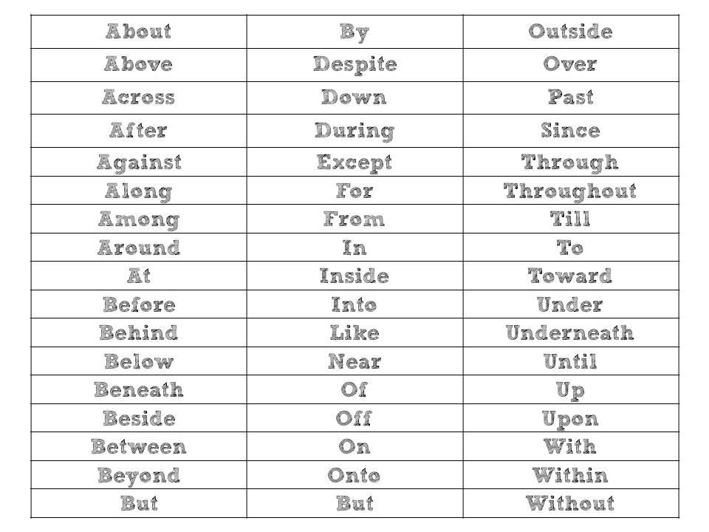

Slide 4
Object of a Preposition
The noun or pronoun that follows a preposition
Example: The average four-year old asks 437 questions during a single day.

Slide 5
Prepositional Phrase
Made up of a preposition, the object of a preposition, and all the words in between..
Example:
The average four-year old asks 437 questions during a single day.

Slide 6
Phrases continued…
A prepositional phrase that modifies a noun or pronoun is functioning as an adjective phrase.
Remember that adjectives tell-what kind, how many, or which one.
The whale with the unusual markings is our favorite.
A prepositional phrase that modifies a verb, adjective, or another adverb is functioning as an adverb phrase.
Remember that adverbs tell how, when, where, how often, and to what extent.
The whales in the water park show performed with ease.

